Slide 1

Heart Disease Prediction Using ML
Emine Erdogan
April 25, 2023
Springboard
Notes:
Line spacing + Page numbers

Slide 2

Agenda
01 Introduction
02 Dataset
03 Exploratory Data Analysis
04 Preprocessing
05 Models
06 Model Optimization - Winning Model
07 Conclusion

Slide 3
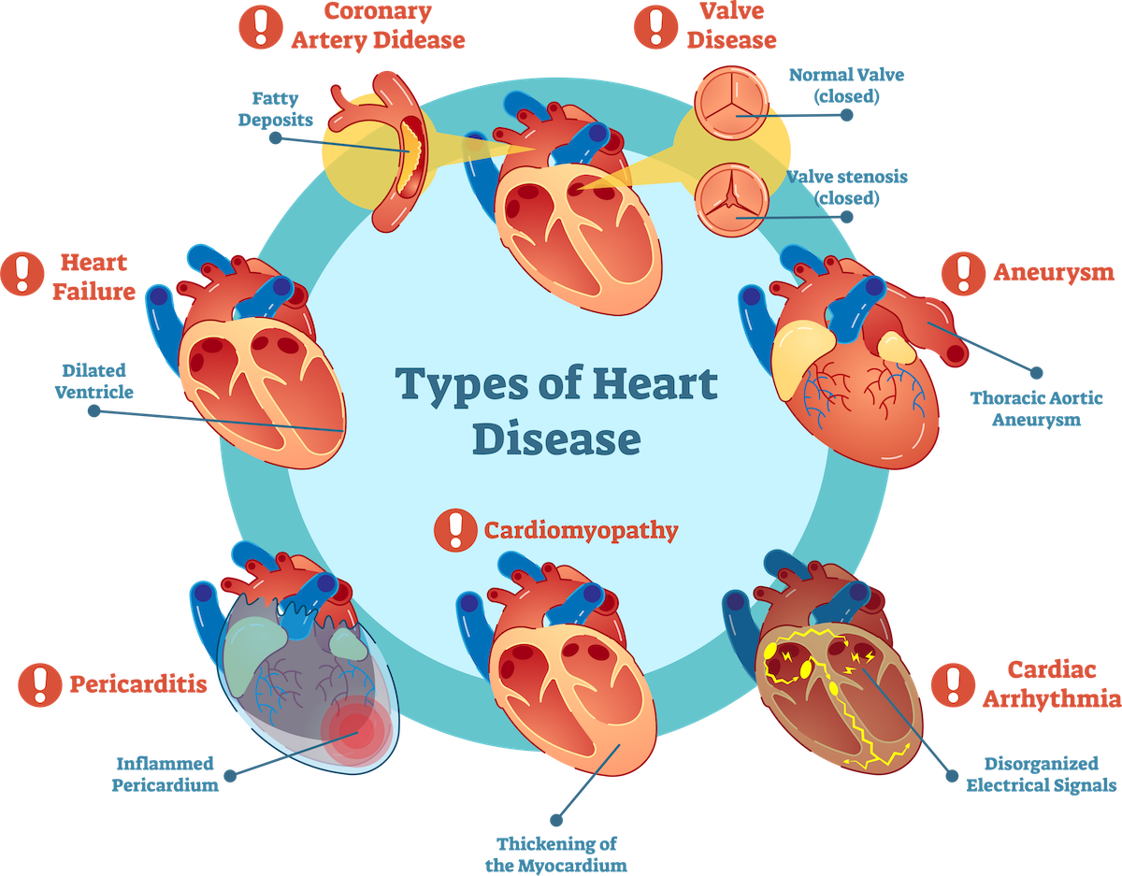
Introduction
01
Cardiovascular diseases (CVDs)
-- #1 cause of death globally
-- ~17.9 million people each year
-- 31% of all deaths worldwide
-- 4/5 CVD deaths 🡺 heart attacks and strokes
-- 1/3 of these deaths under 70 yo

Slide 4
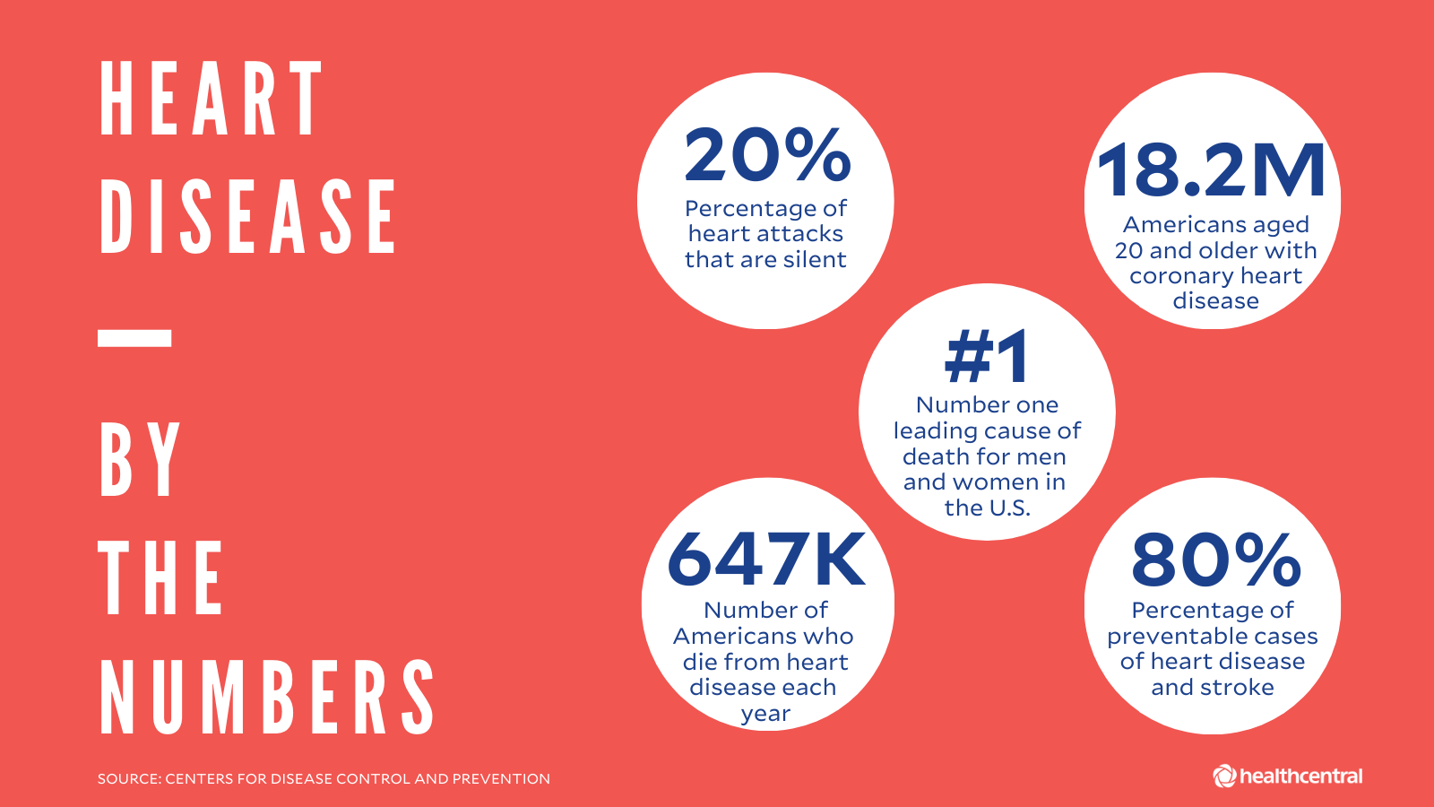
Introduction
01
-- It is very costly health problem, but it is also preventable!
-- ML models can identify heart disease patterns for prediction and classification!

Slide 5
01 Introduction
Research problem:
Can we accurately predict the presence of heart disease using machine learning techniques?
Objectives:
To develop a machine learning algorithm to classify heart disease accurately
To evaluate the performance of the developed models
To determine the factors that significantly affect heart disease classification and prediction
To identify the best ML algorithm for heart disease prediction.

Slide 6
Dataset
02
5. Cholesterol
6. Fasting blood sugar [1: if Fasting BS > 120 mg/dl, 0: otherwise]
7. Resting electrocardiogram results
Max heart rate [Numeric value between 60 and 202]
Exercise-Induced Angina
Old peak (ST numeric –in depression)
The slope of the peak exercise
Heart Disease (1-HD, 0: Normal)
Kaggle Data
918 participants
12 features
No missing value
Age
Sex
Chest Pain Type
Resting BP

Slide 7
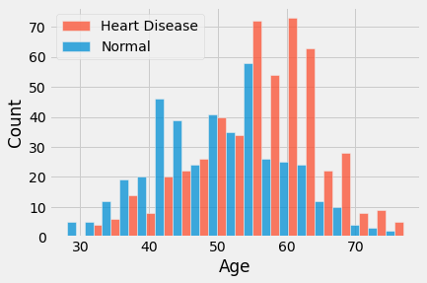
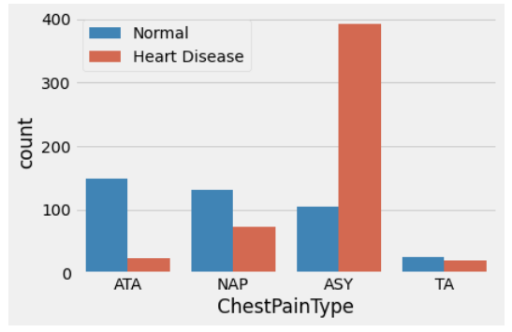
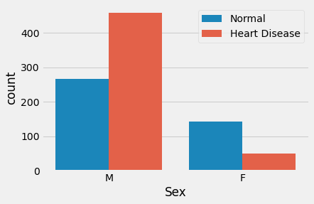
03 Exploratory Data Analysis

Slide 8
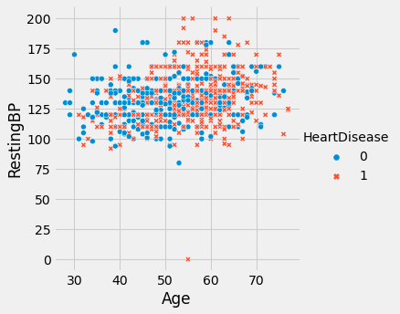

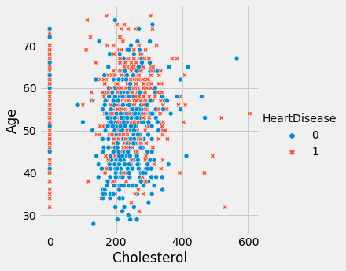

Slide 9
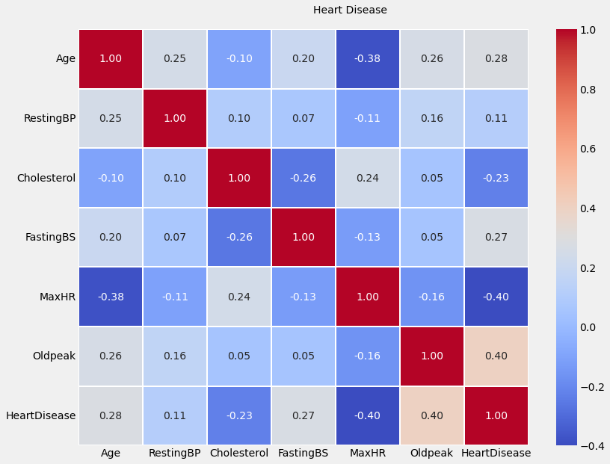

Slide 10

Preprocessing
04
Categorical features
Sex
Chest Pain Type
Fasting BS
Resting ECG
Exercise Angina
ST_Slope
Logistic Regression
Creating Dummies
for Categorical Features
Decision Tree
Encoding ordinal features and Scaling Data
Numerical Features
Age
Resting BP-
Cholesterol
Max HR
Old peak
Heart Disease
Converting Fasting Blood Sugar
🡺
an object variable

Slide 11
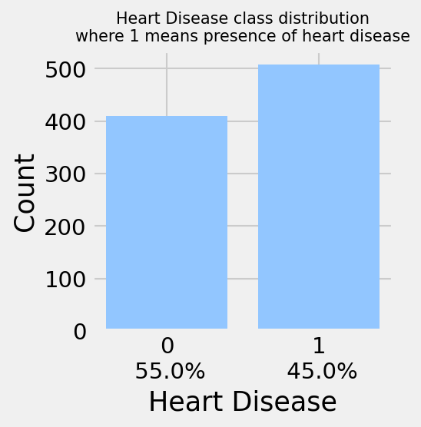
Models (LR & DT)
05
Data Split
X = Cholesterol, Resting BP
X = All features
y = Heart Disease
80%/10%/10%
Heart Disease
Class Count
508/ 410
No balance issue in the data

Slide 12



05 Models
Logistic Regression (with two variables)
Recall Score: 0.79
Logistic Regression (with all variables)
Recall Score: 0.92
Decision Tree
Recall Score: 0.80

Slide 13

06 Model Optimization
Cross Validation with 5 folds
GridSearchCV
Best Parameter = C:1
Recall Score after tuning the model: 0.91
Default Model is kept

Slide 14
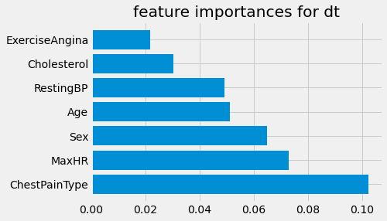
Best Feature Selection
--Chest Pain Type is the most important feature

Slide 15
07 Conclusion
Logistic Regression gives the best recall score - 92% | This means that LR model is the best ML algorithm for heart disease prediction, and it can accurately predict the presence of heart disease.
Chest pain type is the best feature to predict heart disease Greater proportion of the patients who have Asymptomatic chest pain have heart disease. | A greater proportion of male patients have heart disease than female patients.
Heart disease is more common among the older patients as we expected. | Greater proportion of older patients who have high cholesterol have heart disease than younger patients.

Slide 16


Thank you!

